Slide 1

UTILITARIAN APPROACH
Impartiality and Aggregationalism
-By Jeremy Bentham and
John Stuart Mill

Slide 2

What is Utilitarianism
It is an ethical approach that advocates an action based on its consequences; focusing on the morality of the decision taken.
Actions whose result increase happiness or diminish pain are moral/good. They have utility and quality.
The decision must counter/balance the cost/benefit for the greatest number of individuals/stakeholders or we can say constrict the loss/harm for most people.

Slide 3
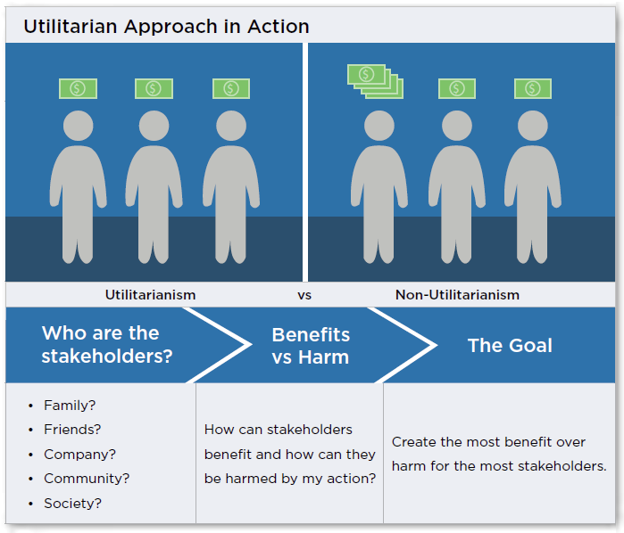
OBJECTIVES
Applications Of Utilitarianism
Political Economy In democracy government takes decisions to ensure safety and availability of resources to citizens which also affect their personal lives. So the decision taken by bureaucrats must aim at society’s greater economic well being.
Business and Ethics When deciding a new scheme or product to be released in the market; the owners ensure that the products must benefit the greater good including the workers, customers and the stakeholders.
Corporate Workplace Companies/firms aim at being socially responsible and trustable brand to increase its market reputation. Thus they work according to the rules of ethics which ensures the benefits of the owners, workers and consumers equally.
Decision taken during wars and while constituting new laws : In such cases always the Utilitarian Approach is accepted to secure the safety and welfare for the larger section of the society.

Slide 4

Examples of Utilitarian Approach
An example of utilitarianism could be when pharmaceutical companies release drugs that are approved by the government, but with known minor side effects, are able to help more people than the people bothered by the side effects.
If a house stands in the way of a highway a utilitarian perspective may argue that house should be bulldozed thus benefiting millions of people getting Faster access to work every day than one person losing their house in return of the same amount of monetary value/property
If in a hospital,five people are requiring transplants - for different body organs. On the other side there is a patient who has been in a coma for several years, whose relatives are requesting for mercy killing. The utilitarian theory for greatest good theoretically justifies saving the lives of more people than the one.
Impartiality

Slide 5


Impartiality is the principle of making ethical decisions without favoring any particular individual or group.
WHAT IS IMPARTIALITY

Slide 6


Equal Consideration: All individuals' interests and well-being are considered equally.
No Special Privileges: No one receives special treatment based on identity or relationships.
PRINCIPLE OF
IMPARTIALITY
Universal Application: Moral rules apply universally, without exceptions.
Conflict Resolution: Decisions are made by evaluating overall happiness without personal bias.

Slide 7

Application: Impartiality guides decision-making in diverse areas, including public policy, ethics, and personal choices.
Real-World Application and Challenges
Challenges: This include identifying personal biases, addressing conflicts of interest, and balancing ethical values.

Slide 8

What is Aggregationalism?
The sum total of the individual utility and beliefs together forming the decision to be taken by any organisation/political party/or company – so as to maximize overall profit or happiness.
The goal here is to promote individual good . This becomes crucial while taking decisions in matters of public interest of general welfare.
Here the value is given to quantity. The more number of lives or benefits a decision carries the greater is its impact – thus advocating proper use of aggregationalism in utilitarianism.
Aggregationalism works better when combined when impartiality. The goal remains same – to focus on individual units of happiness or sufferings while taking a decision such that it benefits all.
To maximize the profit on a larger scale – we should count equally the individual beliefs and welfare of people. The aim of the outcome should result in benefiting the maximum lives possible.

Slide 9

Key Points In Aggregationalism
Hedonistic Calculus: Aggregationalism in Utilitarian approach uses a hedonistic calculus to measure happiness and suffering. This involves considering factors such as intensity, duration, certainty, propinquity, purity, and extent when assessing the utility of an action.
Maximizing Happiness : : Aggregation in utilitarianism refers to the process of summing up individual happiness or suffering to determine the overall utility of an action. Utilitarianism aims to maximize overall happiness or well-being and treats each individual's well-being as of equal moral importance in this calculation.
Consequentialism: Utilitarianism is a consequentialist theory, which means it focuses on the outcomes or consequences of actions rather than the inherent moral quality of the actions themselves. The action that leads to the greatest overall utility is considered morally right.

Slide 10


Challenges and Criticisms of Aggregationalism
Aggregationalism faces critiques related to the potential disregard for individual rights or minority interests, as well as difficulties in accurately measuring well-being.
Balancing Act: Balancing the interests of the many against the rights and interests of the few is a central challenge.

Slide 11
Example of Aggregationalism in Practice
Suppose you have $1,000 to donate to charitable causes, and you're deciding how to distribute it to maximize overall happiness. You have two options:
Option A: Give the entire $1,000 to a single charity that provides clean drinking water to a village in a developing country. This donation will enable the entire village to access clean water for an extended period, significantly improving their health and quality of life.
Option B: Divide the $1,000 among five different charities, each addressing various social issues but not to the same extent. Each charity receives $200, which may have a positive impact but might not be as transformative as providing clean water to an entire village.Utilitarian aggregationism would recommend choosing
Option A because it maximizes the overall well-being by concentrating resources where they can have the greatest impact, even though it means not distributing aid to other causes. In this way, it prioritizes the collective welfare over spreading resources thinly across multiple causes.

Slide 12

Thank You
Mangesh (500125990)
Anuj Mishra (500125988)
Shipra Nayal (500125110)
Soniya (500126096)
Sachin Rawat ()

